Slide 1
Java Lecture 2

Slide 2
Introduction to Java part 2
Editions of Java
  Standard Edition
    Java 2 Standard Edition(J2SE)
    For Desktop and distributed application
  Enterprise Edition
    Java 2 Enterprise Edition(J2EE)
    For Web and Enterprise
  Micro Edition
    Java 2 Mobile Edition(J2ME)
    For mobile and other micro devices

Slide 3
Introduction to Java part 2
Technologies in Java
  Desktop Technology
    Java 2 core part
    Scope: Desktop / LAN
  Distributed Technology
    Remote method invocation(RMI) library
    Scope: Distributed Storage and Distributed Processing.
  Web Technology
    Applets , Servlets, JSP.
    Scope: Internet/Intranet/Extranet.
  Enterprise Technology
    J2EE
    Scope: Enterprise Applications.
  Micro Technologies
    J2ME
    Mobiles , PDAs

Slide 4
Java Basics
Comments in Java
  Three types of comments in java
    Using //:
        Simple comment
    Using /* and */:
        Block of comments without documentation
    Using /** and */
        Block of comments with automatic documentation.

Slide 5
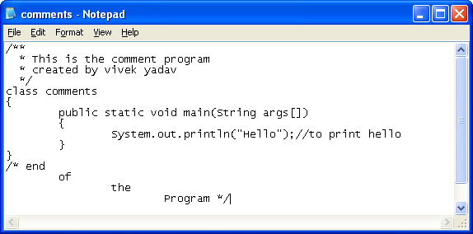
Java Basics
Comments in Java Example

Slide 6
Java Basics
Literals
  f, d, l are the literals in java
  These are used to specify the data type of a value
Examples
  10 //integer value
  10.5 //double by default
  10.5d //double
  10.5f //float
  10l //long

Slide 7
Java Basics
Type Casting
  Conversion from one data type to other.
  In java there are two type of type castings:
    Narrowing/Explicit
      Converting from larger to smaller data type.
    Widening /Implicit
      Converting from smaller to larger data type.
  Example:
    int i=10; long j=20;
    i=j; //incorrect
    i=(int)j //correct
    j=i; //correct
    J=(long)I; //correct

Slide 8
Java Basics
String to integer conversion.
  Integer.parseInt() fuction is used to convert String to integer.
    Syntax:
        int Integer.parseInt(String);
    Example:
        int a=Integer.parseInt(“20”);
Mod operator(%)
    To find reminder.
    Example : int a=10%3; //a=1

Slide 9
Looping in java
For Loop
  Syntax:
      for ( intialization; condition ;incrementation /decrementation)
        statements to run while condition is true
  Example :
      for(int i=0;i<10;i++)
        System.out.println(“Hello”);
  Control flow of for loop
    Initilization
    Condition check
    Statement run
    incrementation /decrementation
    Condition check

